Slide 1
BT201
Biochemical Process Calculations
16/11/2022
Part 2

Slide 2
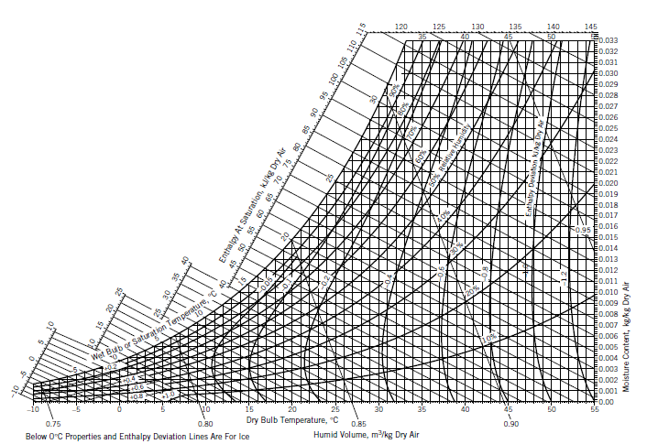
Psychrometric chart (humidity chart)
On a Psychrometric chart (humidity chart) several properties of a gas–vapor mixture are cross-plotted, providing a concise compilation of a large quantity of physical property data.
The most common of these charts—that for the air-water system at 1 atm
Used extensively in the analysis of humidification, drying, and air-conditioning processes.
Once you know the values of any two of these properties, you can use the chart to determine the values of the others.

Slide 3
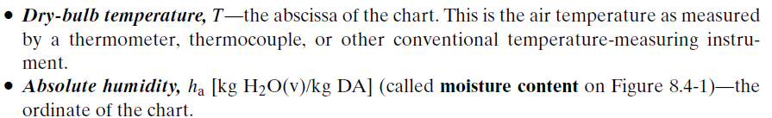
Psychrometric chart (humidity chart)
This ratio can easily be calculated from or converted to the mass fraction of water.
If, for example, the absolute humidity is 0.0150 kg H2O/kg dry air (DA), then for every kilogram of dry air there is 0.015 kg of water vapor, for a total of 1.015 kg.
The mass fraction of water is (0.0150 kg H2O) /(1.015 kg humid air) =0.0148 kg H2O/kg.

Slide 4

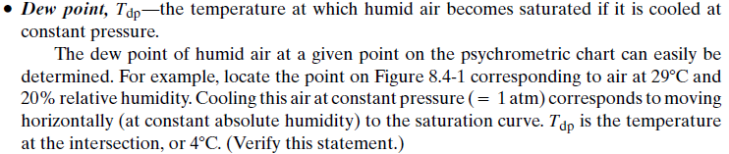

Slide 5
Psychrometric chart (humidity chart)

Slide 6
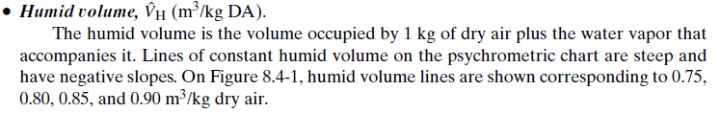
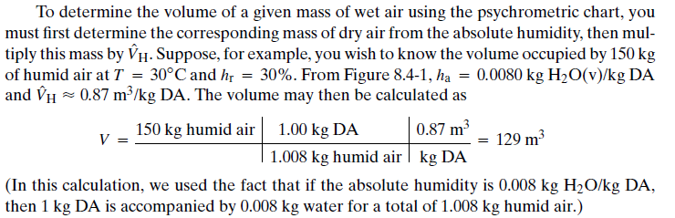

Slide 7
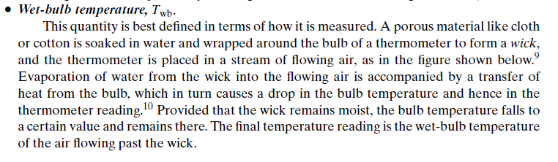
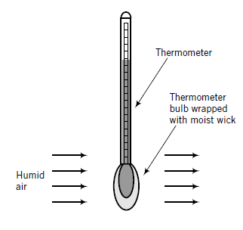

Slide 8
The wet-bulb temperature of humid air depends on both the dry-bulb temperature and
the moisture content of the air.
If the air is saturated (100% relative humidity), no water evaporates from the wick, and the wet-bulb and dry-bulb temperatures are the same.
The lower the humidity, the greater the difference between the two temperatures
For example, suppose you wish to determine the wet-bulb temperature of air at T=30 C(dry
bulb) with a relative humidity of 30%.
Locate the point on Figure at the intersection of the vertical line corresponding to 30 C and the curve corresponding to h_{r}=30%.
The diagonal line through the point is the constant wet-bulb temperature line for air at the given condition.
Follow that line upward to the left until you reach the saturation curve.
The temperature value you read on the curve (or vertically down from it on the abscissa) is the wet-bulb temperature of the air. You should get a value of 18 C.
This means that if you wrap a wet wick around a thermometer bulb and blow air with T=30 C and h_{r}=30% past the bulb, the thermometer reading will drop and eventually stabilize at 18 C.

Slide 9
Psychrometric chart (humidity chart)

Slide 10
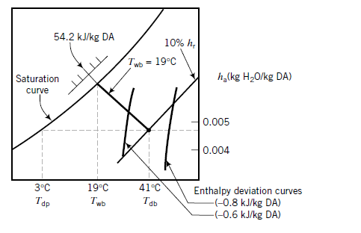
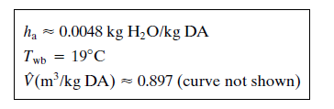
Use the psychrometric chart to estimate (1) the absolute humidity, wet-bulb temperature, humid
volume, dew point, at 41 °C and 10% relative humidity, and
(2) the amount of water in 150 m³ of air at these conditions.
Following is a sketch of the psychrometric chart showing the given state of the air:
From chart

Slide 11

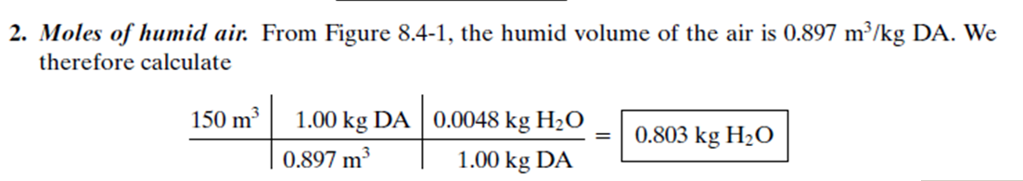
The dew point is the temperature at which the air with the given water content would be
saturated at the same total pressure (1 atm) and is therefore located at the intersection of the
horizontal constant absolute humidity line (h_{a}= 0 0048) and the saturation curve, or

